Slide 1
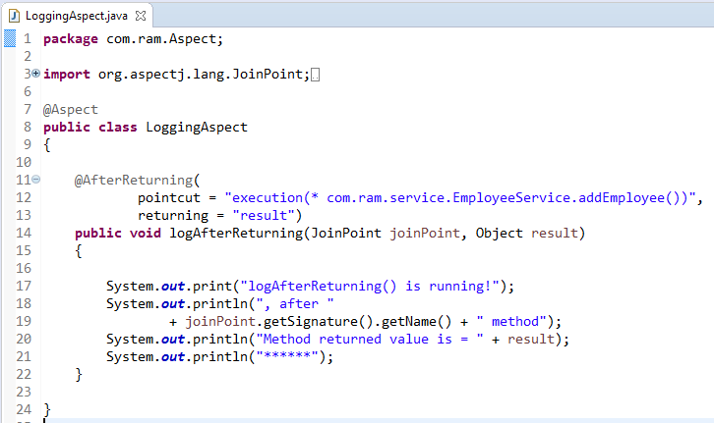
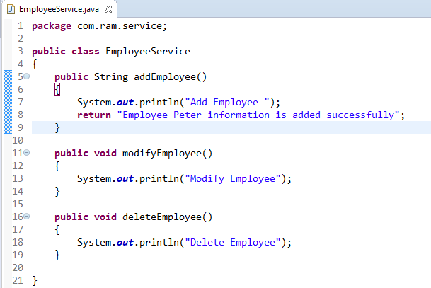
AspectJ @AfterReturning
@AfterReturning declares the after returning advice. It is executed after calling the actual method and before returning result. But you can get the result value in the advice.
method
@AfterReturning
AspectJ “pointcuts” is used to declare which method is going to intercept
1
2

Slide 2
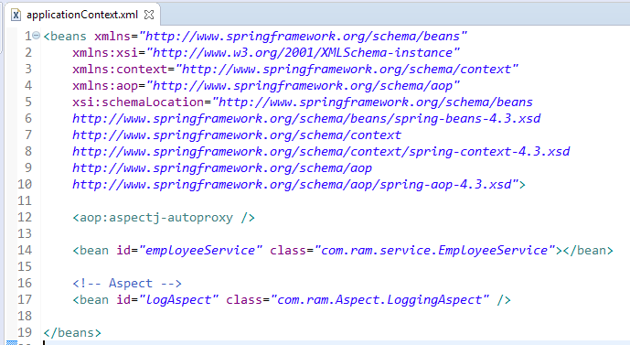
To Enable AspectJ, In Spring configuration file, put “<aop:aspectj-autoproxy />“, and define your Aspect (interceptor) and normal bean

Slide 3
